Slide 1
DEEP LEARNING For Recognizing Hand-Written Digits
Presentation by
OMKAR GUJJA ( 71 )
SHASHIKANT SADHAPHULE (62)
ADVAIT BHOSLE (72)
Under the Guidance of
Prof. Raghuvendra S. Upadhyay
Department of Mechatronics Engineering
TERNA ENGINEERING COLLEGE NERUL
University of Mumbai

Slide 2
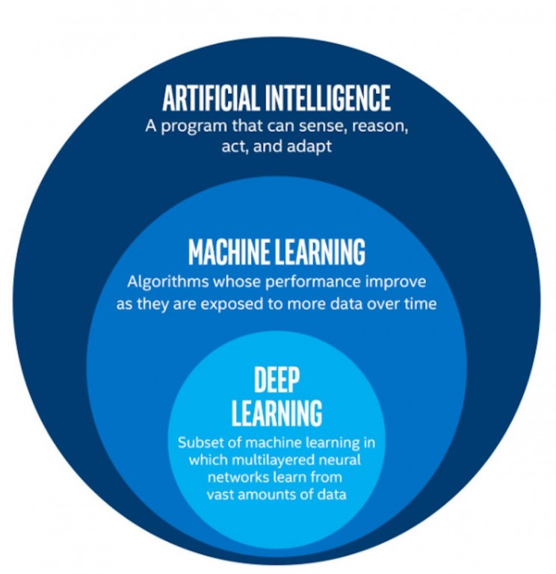
Introduction

Slide 3
Introduction
What is machine learning?
“Algorithms that parse data, learn from that data, and then apply what they’ve learned to make informed decisions”
What is Deep Learning?
Deep learning structures algorithms in layers to create an "artificial neural network” that can learn and make intelligent decisions on its own

Slide 4
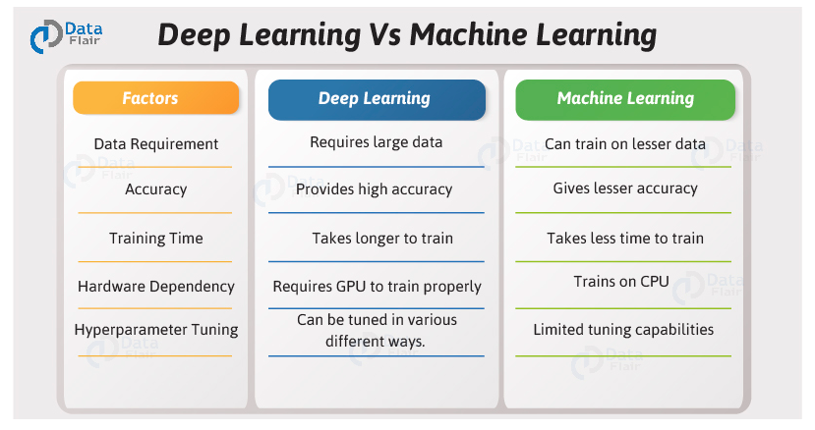
ML vs DL

Slide 5
Pros vs Cons
Advantages of Deep Learning
The deep learning architecture is flexible to be adapted to new problems in the future.
Massive parallel computations can be performed using GPUs and are scalable for large volumes of data.
Disadvantages of Deep Learning
It requires very large amount of data in order to perform better than other techniques.
It is extremely expensive to train due to complex data models.
There is no standard theory to guide you in selecting right deep learning tools as it requires knowledge of topology, training method and other parameters. As a result it is difficult to be adopted by less skilled people.

Slide 6
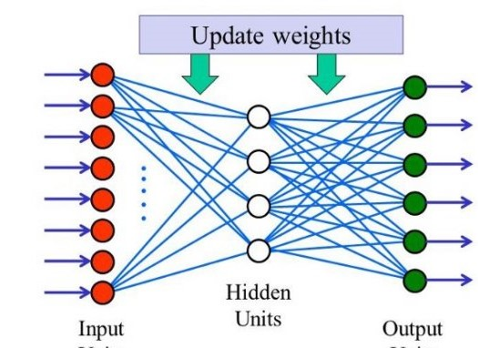
What is Neural Network?

Slide 7
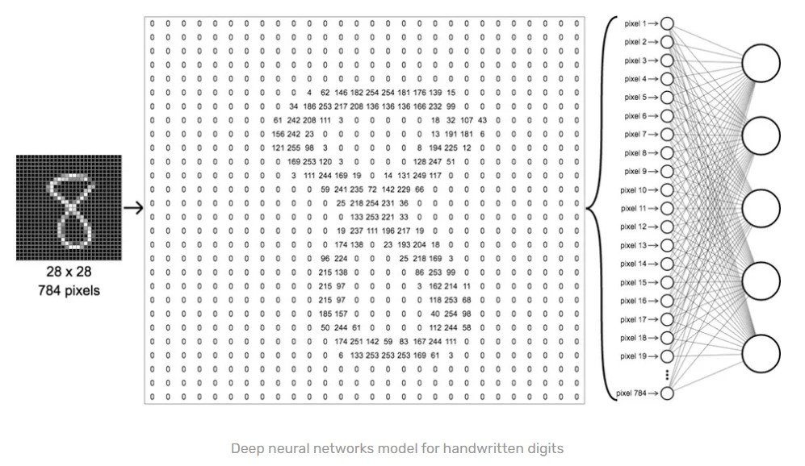
How does Network reads the Image?

Slide 8
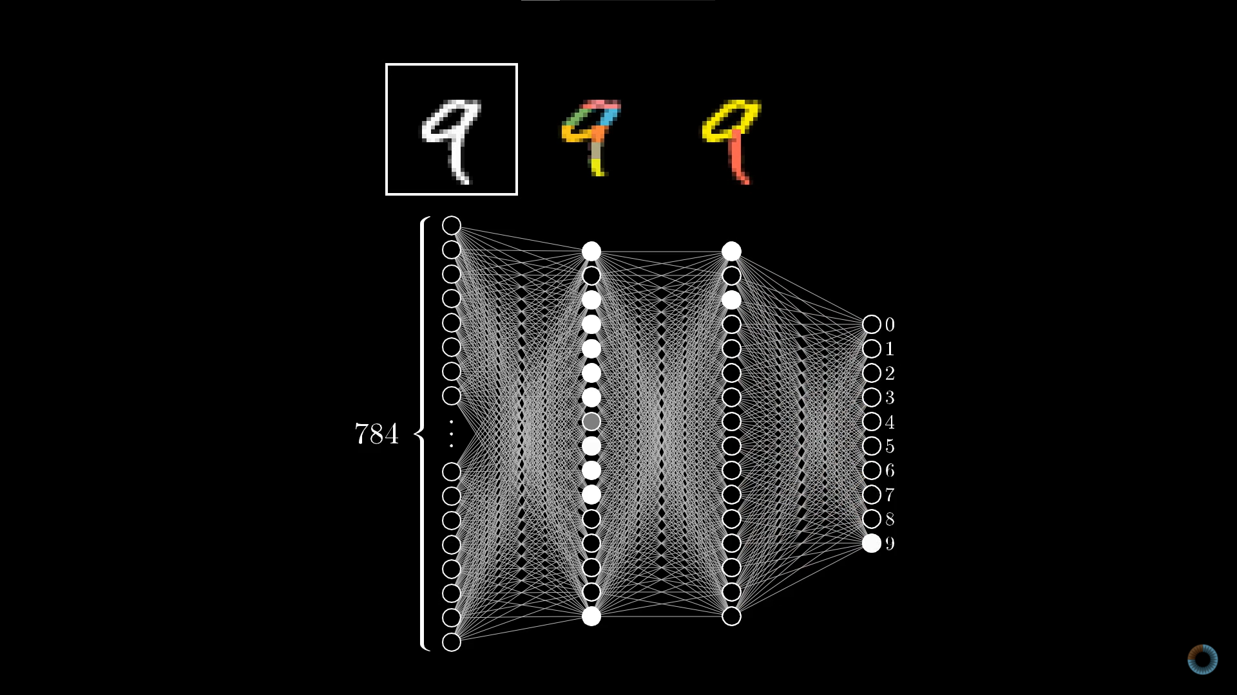
Hidden Layers

Slide 9
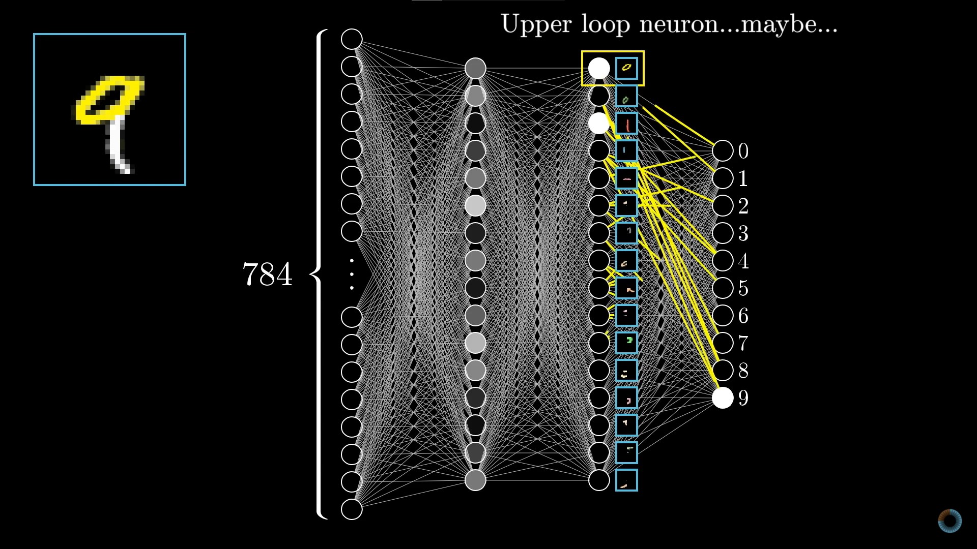
Hidden Layers

Slide 10
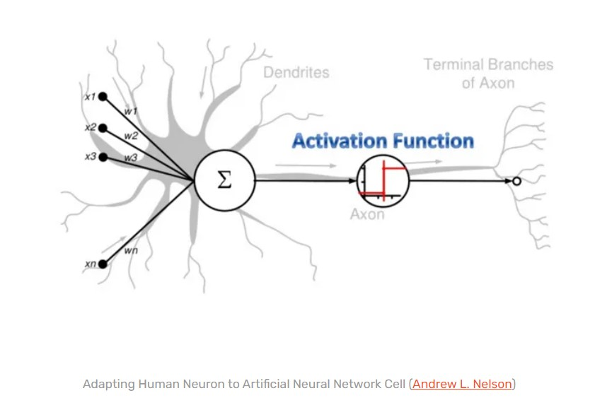
What is Neuron?

Slide 11
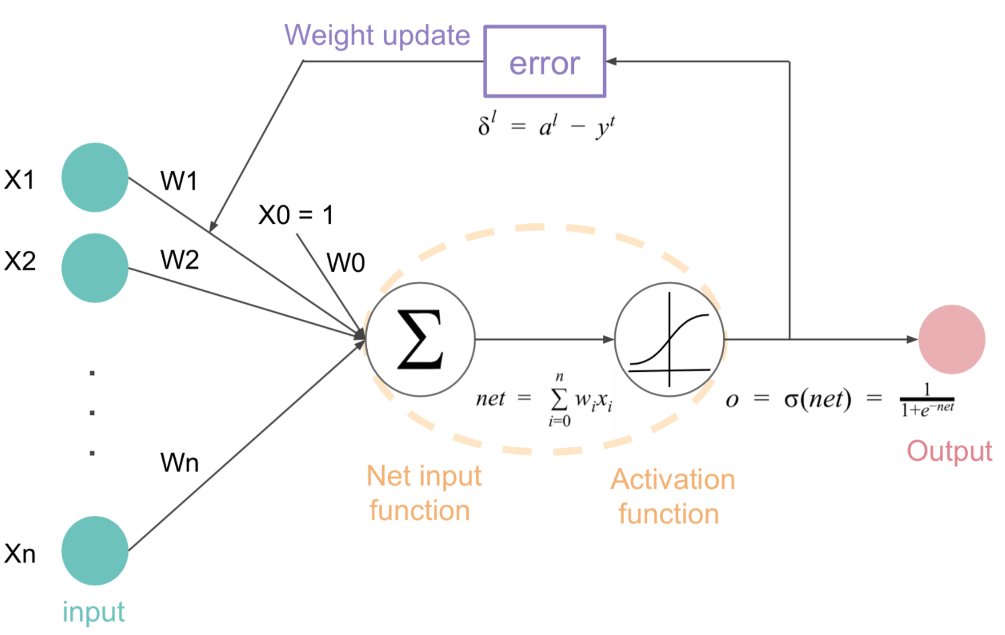
Learning Process

Slide 12
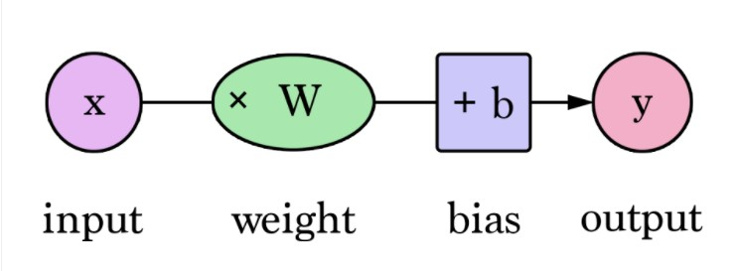
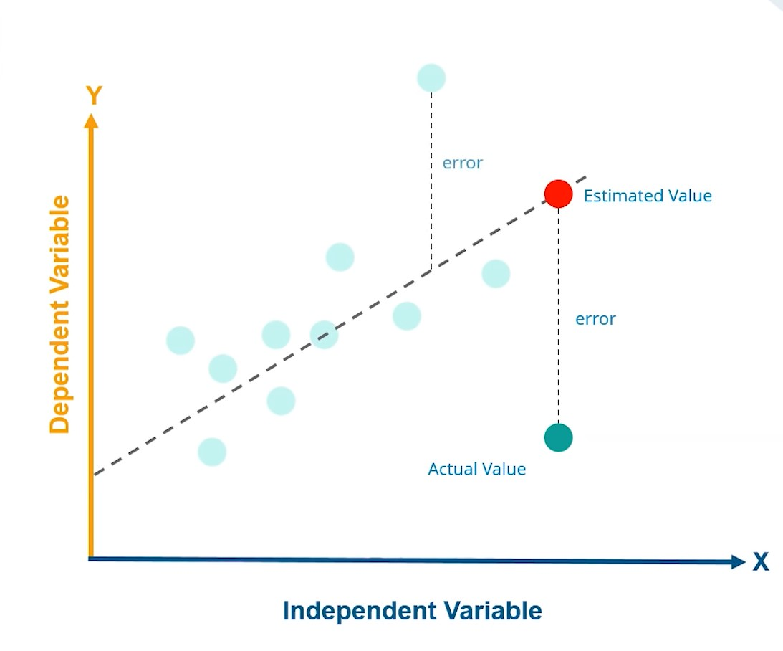
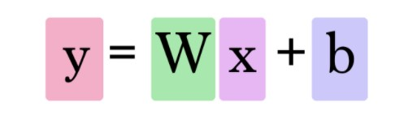
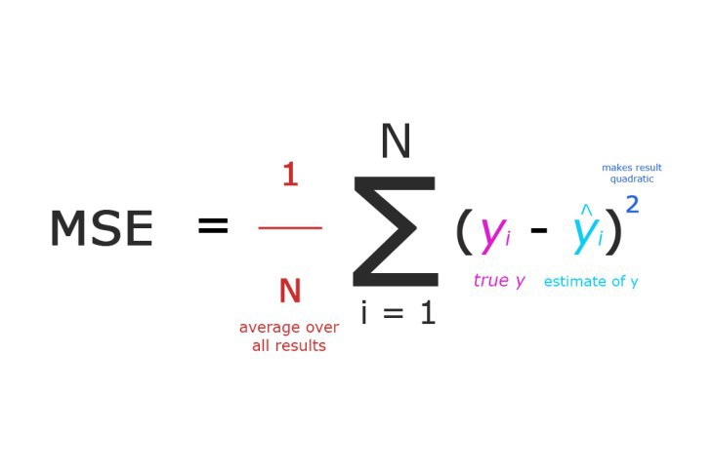
Graphical Form

Slide 13
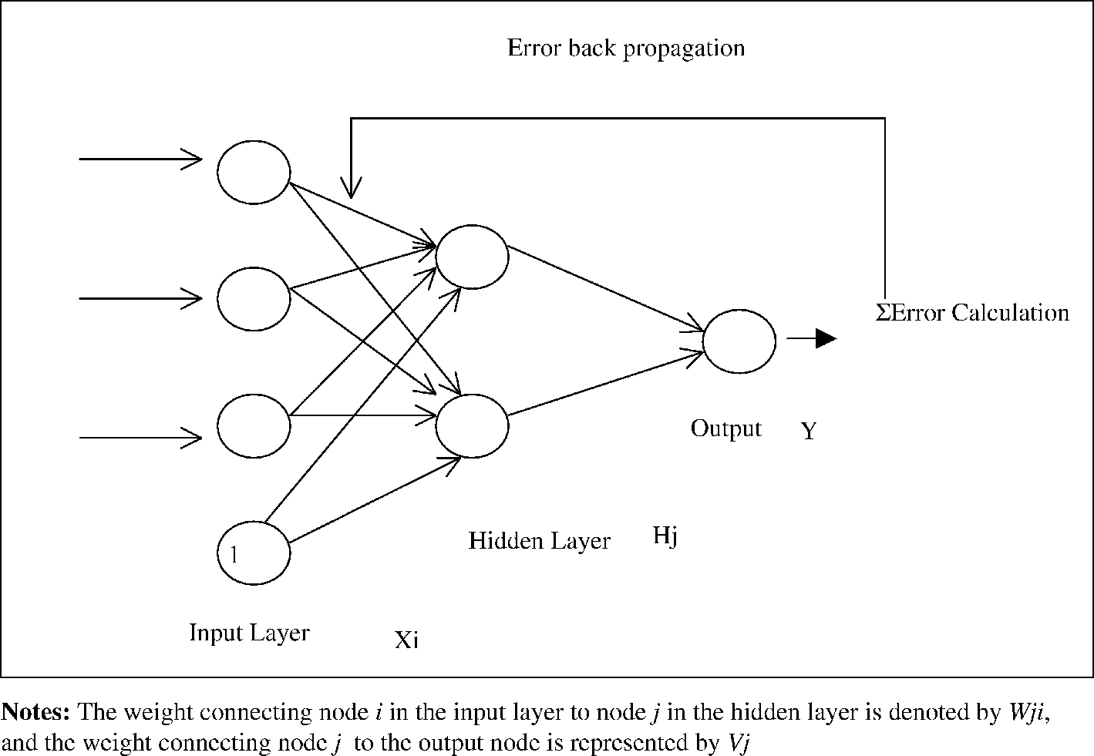
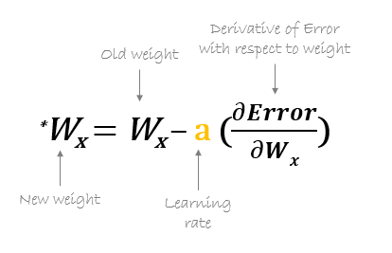
Back-Propagation

Slide 14
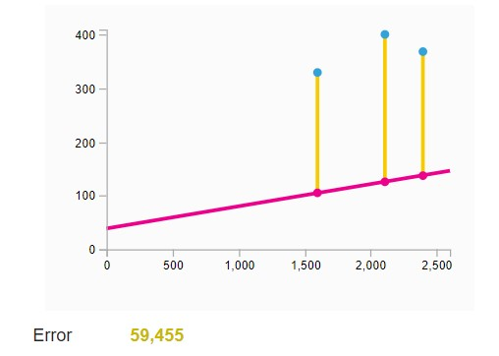
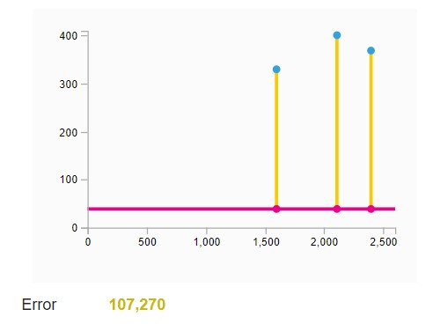
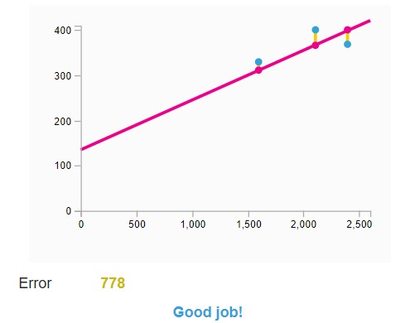
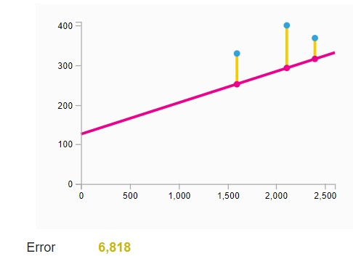
1. 2.
4. 3.

Slide 15

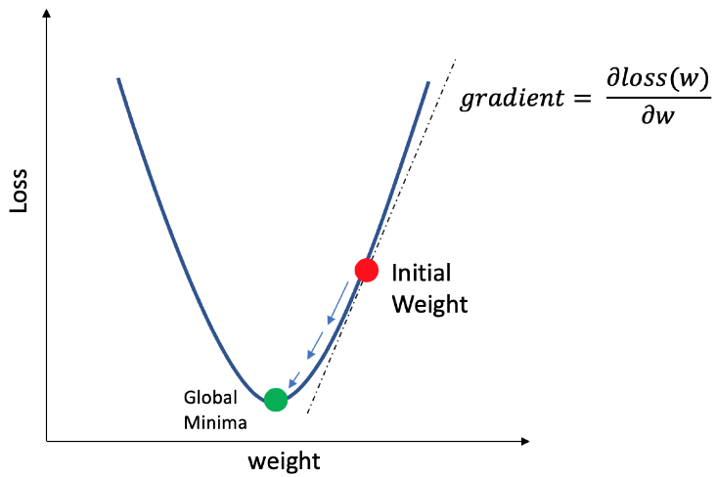
Global Minima

Slide 16
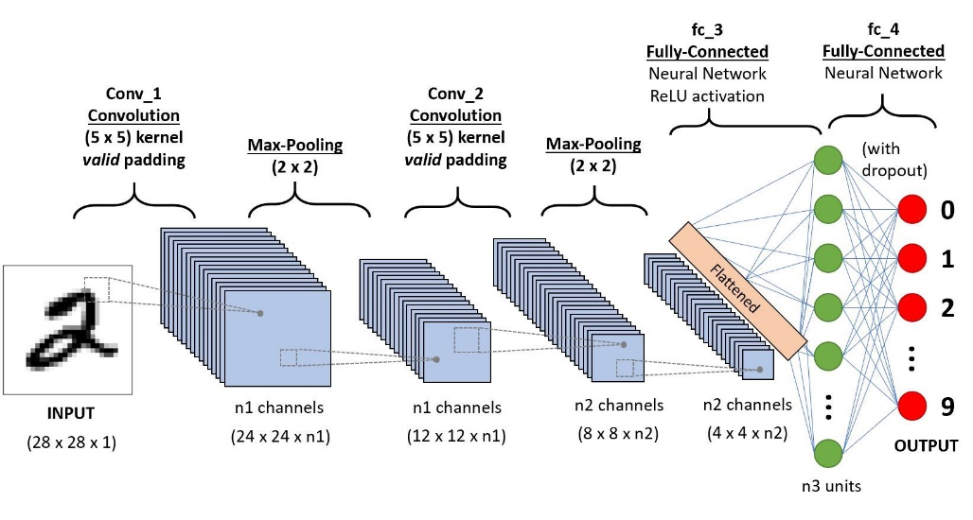
Project Implementation/Methodology
Machine Learning
  Support Vector Machine
  K Nearest Neighbour
Artificial Neural Network
Convolution Neural
Network

Slide 17
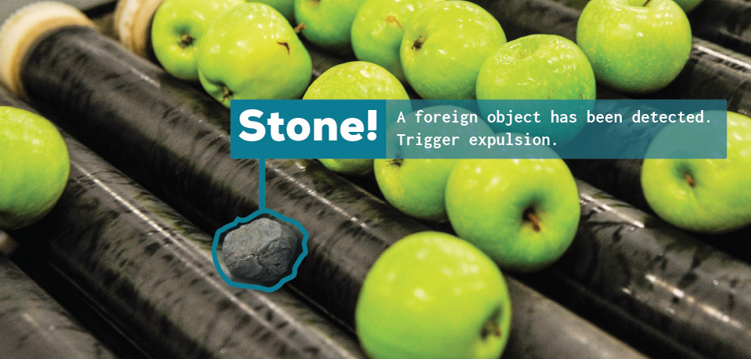
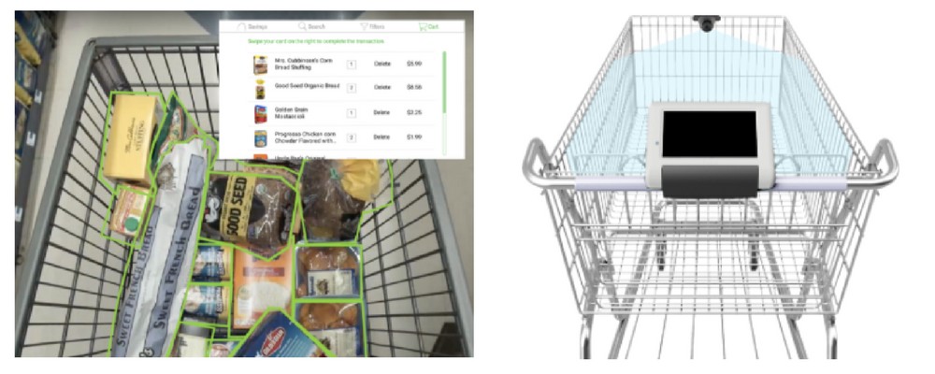
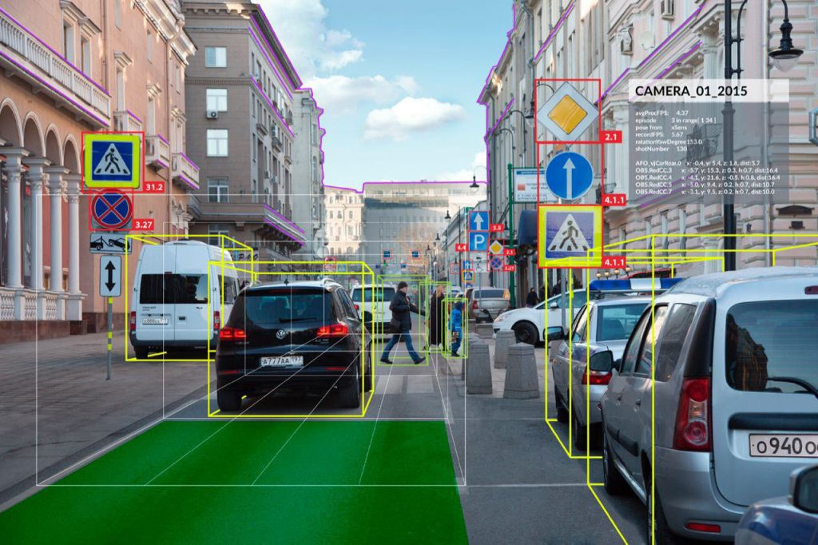
Scope & Applications
Manufacturing – Quality Control
Computational Fluid Dynamics
Medical image processing
Cashier-less stores
Self-driving cars
Surveillance

Slide 18
(Gantt chart)Schedule of project work
(Gantt chart)Schedule of project work
19 march – 23 march | 23 march - 31 march | 1 April– 7 April | 8 April– 15 April | 16 April – 23 April
Purchasing
Making Outer Body
Assembling the Electronics
Assembling the Electronic part with Outer Body
Testing & Troubleshooting
Report

Slide 19
References
https://en.wikipedia.org/wik/Convolutional_neural_network
https://www.zendesk.co/
https://www.youtube.com/watch?v=aircAruvnKk
Handwritten Digit Recognition using CNN
Vijayalaxmi R Rudraswamimath 1 , Bhavanishankar K2

Slide 20
Thank You

